Slide 1
IBM Watson Data Expert Services Learn Notebooks Watson Studio

Slide 2
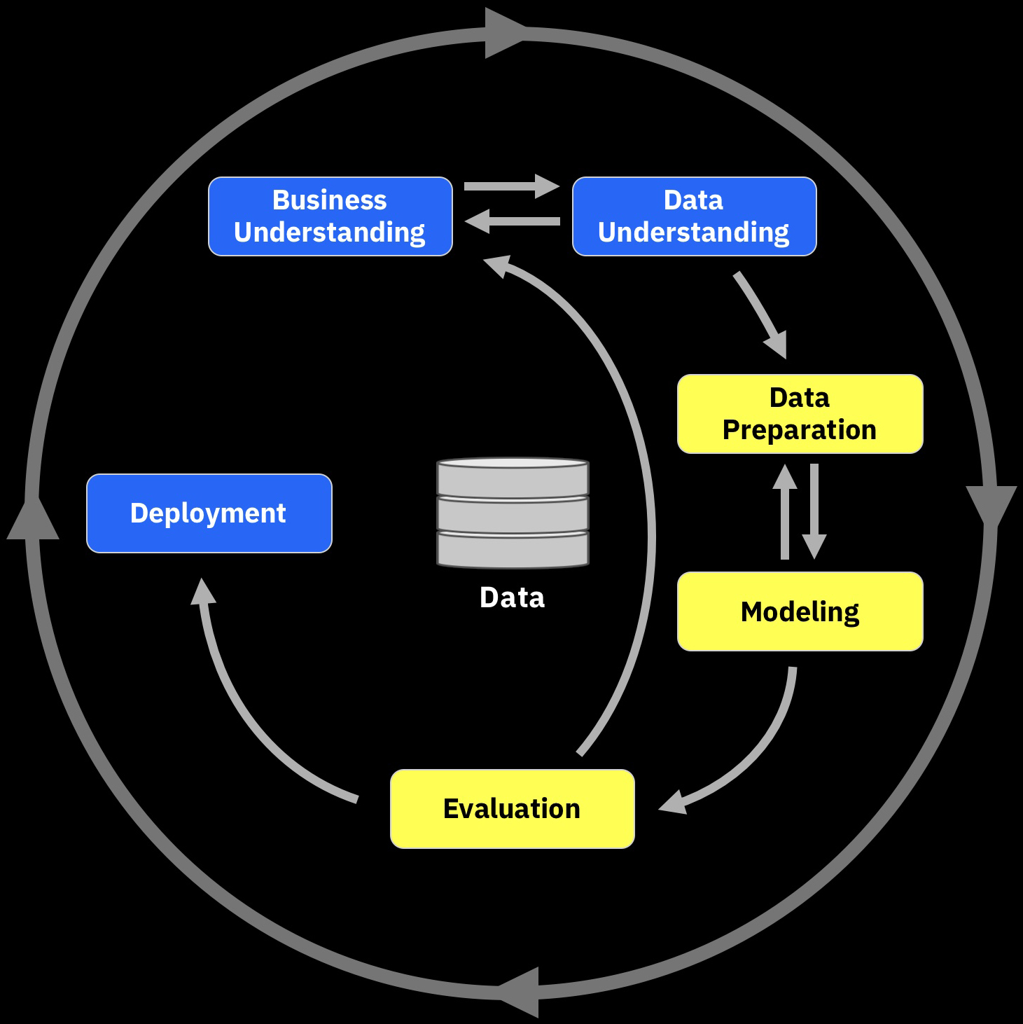
Objectives of This Session
Upon completion of this session you will will have:
Built and published a model to predict customer churn
Utilizing Python in a Jupyter notebook
Including:
Data Visualization
Model Execution
Machine Learning

Slide 3
Conceptual Flow For Churn Analysis
“What are our retention and churn rates across products and geos?”
“How can I get better targeting and success in customer retention?”
Visualize &
Explore Insights
Business Analyst
Fetch Data
VP of Marketing
Curate
“Can we refine our customer segmentation model and develop more refined propensity models?”
Data
Data Steward
Data Engineer
Provide Data or Visualization
Rapid data evaluation and extraction of necessary attributes to support analysis
Discovery through shop for data
Rapid hypothesis testing
Iterative analysis and model building through discovery and collaboration
Deploy scoring models into existing campaign management processes
Fetch Data
Conform
Data
“What data attributes are in the available sets of data which can be used ?”
Data Scientist
Visualize &
Explore Insights
Build Models
Notes:
Introduce the Customer Churn model here…
Focus on the Data Scientist function within the overall process…

Slide 4
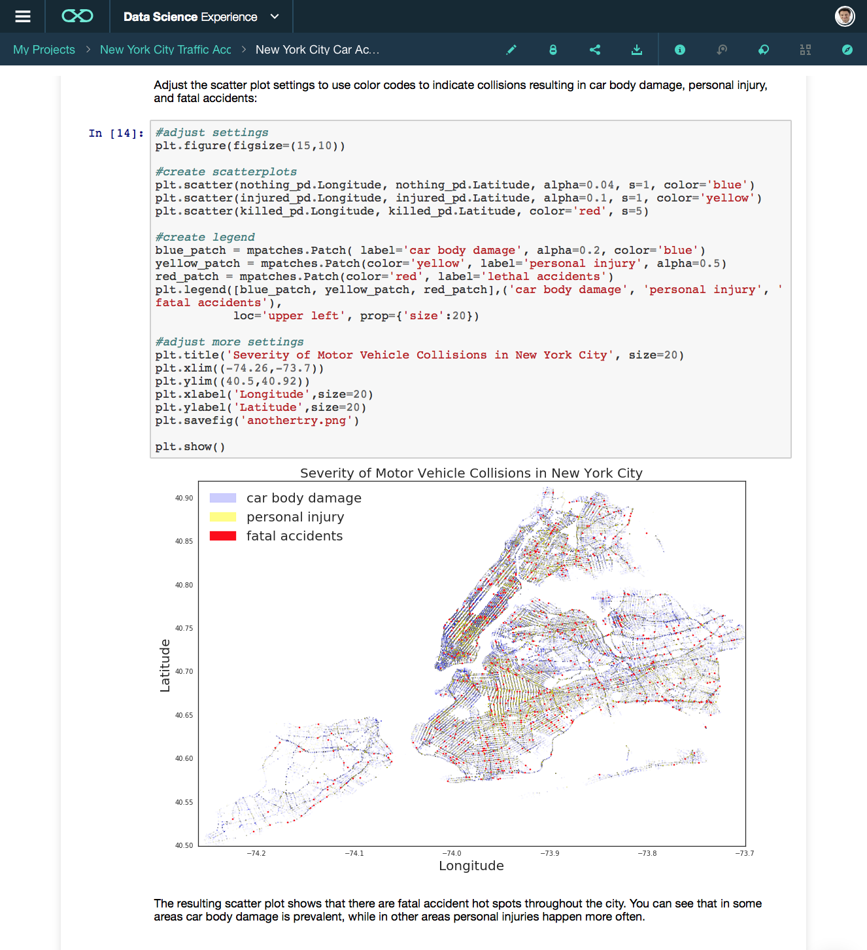
Juypter Notebooks
Just as a scientist documents the step by step investigation and lab steps from hypothesis to interim and final results, a Data Scientist can leverage that same paradigm through tools such as a Jupyter notebook.
“The Jupyter Notebook is an open-source web application that allows you to create and share documents that contain live code, equations, visualizations and narrative text.
Uses include: data cleaning and transformation, numerical simulation, statistical modeling, data visualization, machine learning, and much more.”¹
¹ Definition from https://jupyter.org
Notes:
Discuss the concept of the notebook and cells (what they are, i.e. that they execute code in steps…)
The sample code above the picture depicts the type of logic that a data scientist would develop while creating a model

Slide 5
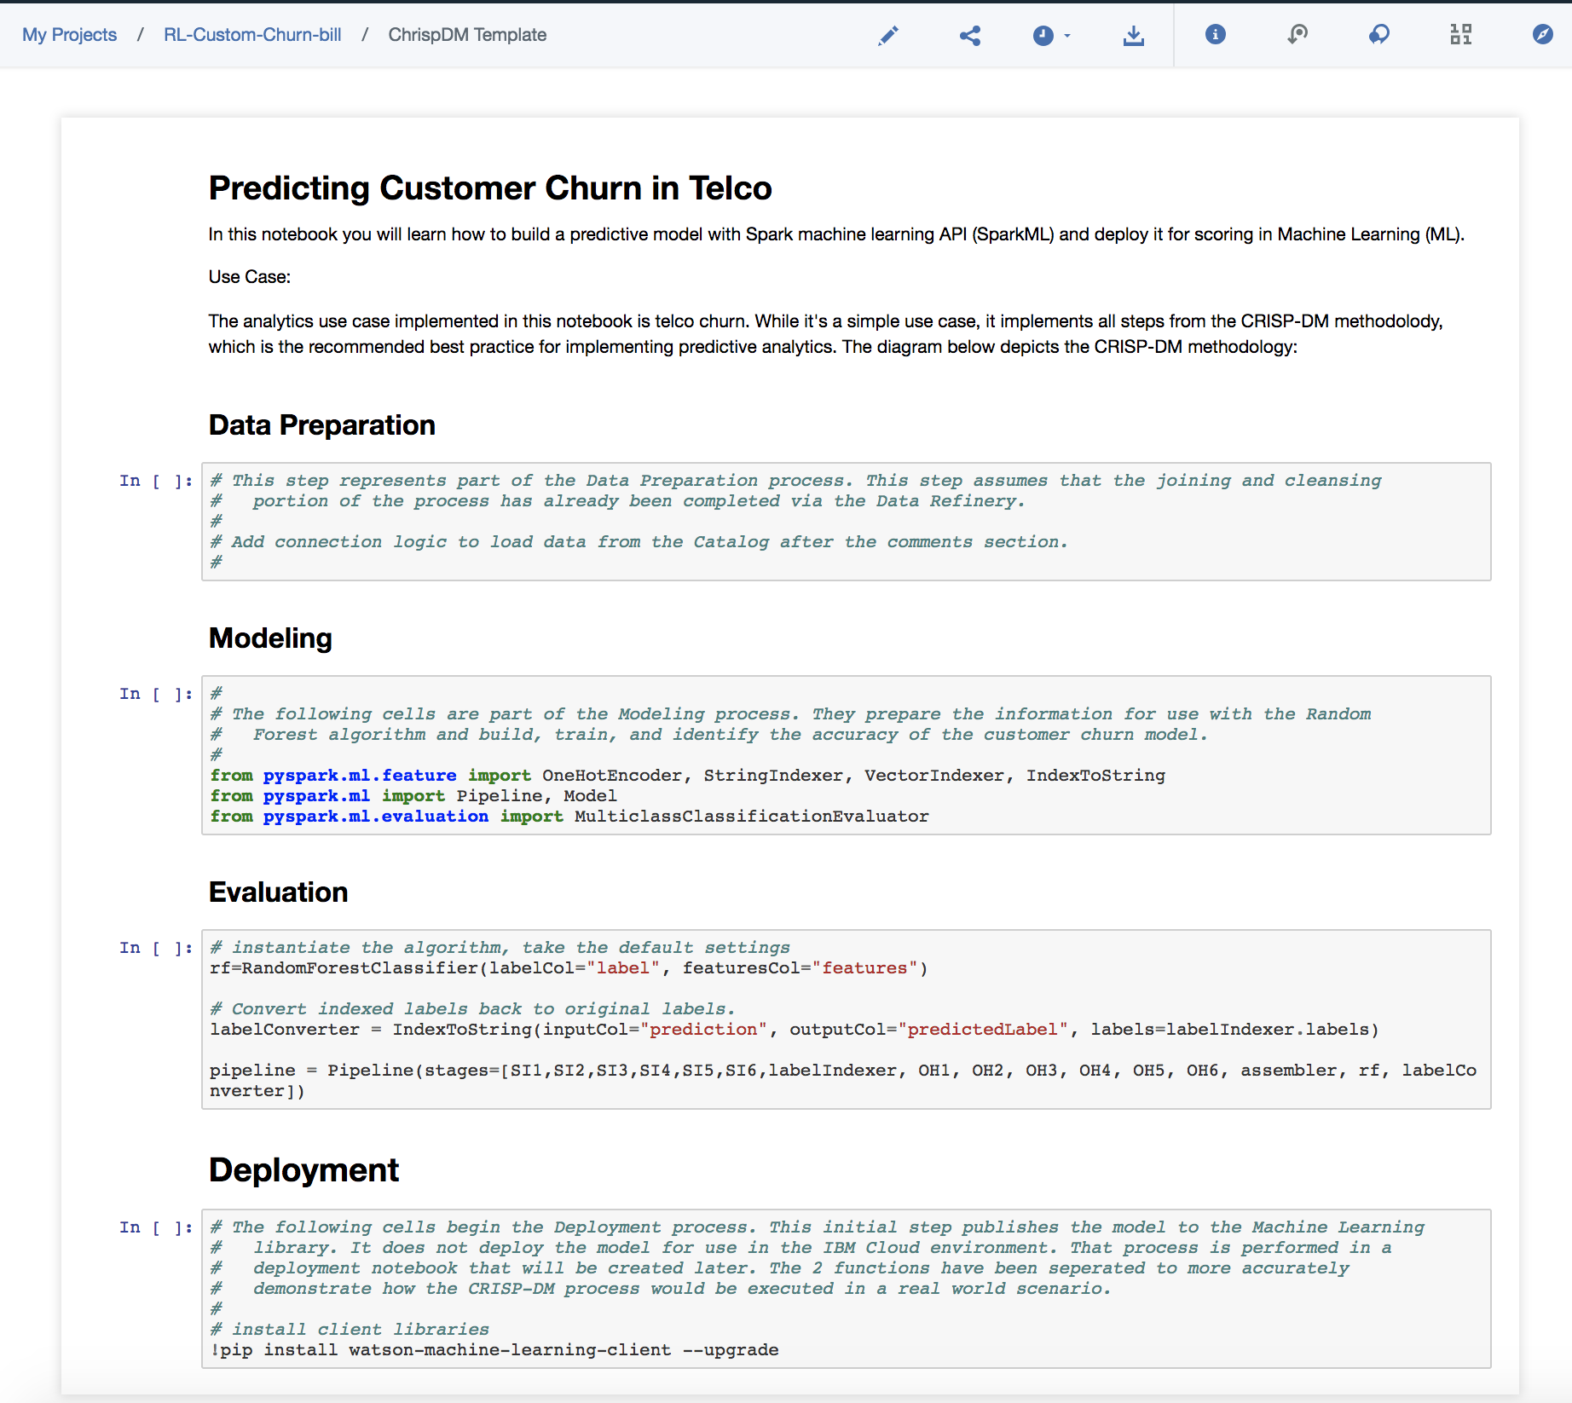
Applying Crisp-DM through a Notebook
A notebook is a free-form means of capturing and documenting the steps taken as the team works through their analysis of a business problem.
Multiple collaborators can work on the notebook
Only one person can have it open for editing at a time

Slide 6
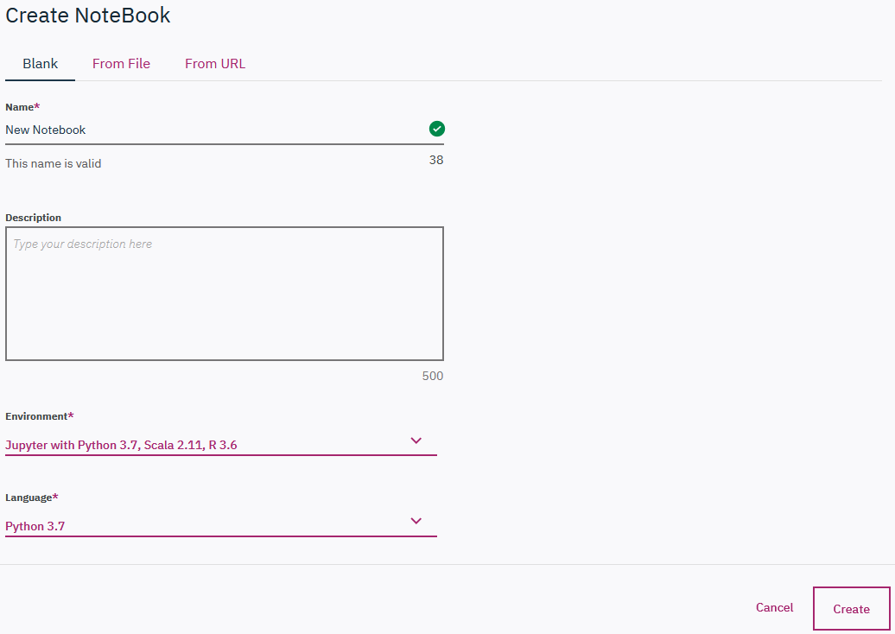
Creating a Notebook - Processing Environment
An environment definition defines the hardware and software configuration that you can use when running your Notebook. Watson Studio offers a selection of default Anaconda-based environment definitions to choose from.
You can choose to use the defaults, or you can create your own environment customized to fit your needs. When you start a notebook associated with an environment, the runtime service creates a runtime instance based on the environment configuration you specified.
Select the environment that best suits your needs based on the volume of data you are processing and whether you use Spark APIs.
If you don't need Spark, you can use the default Anaconda-based environments. If you need Spark, you must associate the notebook with a Spark service.
Notes:
Discuss the different processing environments that are available and the costs that are associated with them. The deciding factor when selecting an Anaconda-based environment is the volume of data you want to analyze and whether you use Spark APIs. If you don't need Spark, you can use the default Anaconda-based environments. If you need Spark, you must associate the notebook with a Spark service.

Slide 7
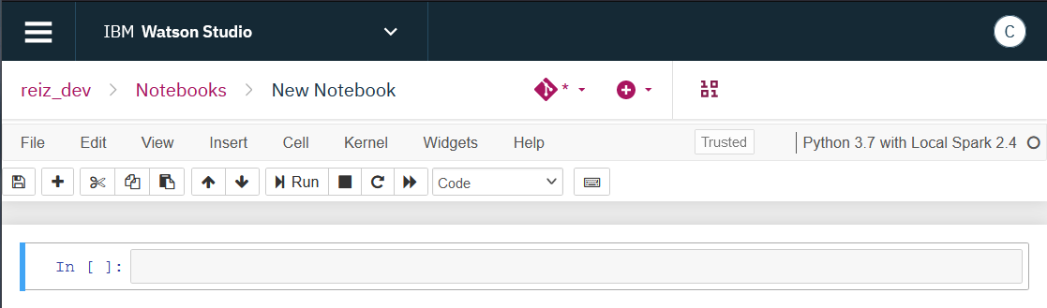
Decrypting the Notebook
GitHub
Create
Data
Environment
Notes:
When you are in the Notebook there are a set of icons across the top which may seem a bit cryptic. The first icon is the GitHub integration. This allows you to publish to GitHub repository, When you are opening an existing Notebook a pencil icon will be displayed and the Notebook is in read only mode. Clicking on the pencil icon will open the Notebook to allow editing and running the cells. The pencil is then replaced with the GitHub icon.
Share allows you to share the notebook with others via a URL. Schedule is what it says, it is for scheduling when the Notebook will run (hourly, daily, weekly, monthly, yearly). Infor tells you about the Notebook (when it was created, by whom, what the environment is). Versions lets you navigate through the set of versions captured for this Notebook. Up to 10 versions can be kept. Comments lets you or your collaborators add a couple of notes. Data allows you to add the data assets you want to work with to the Notebook. Community lets you search through the Watson Studio community without having to leave the Notebook. Lastly, More is for any other tools that may be available.
Cells are where you do your work. The notebook has 4 types of cells - Markdown (text), Code, Raw NBConvert, and Heading.
Each cell with code can be executed independently or together (see options under the Cell menu). When working in this notebook, we will be running one cell at a time because we need to make code changes to some of the cells.
To run the cell, position cursor in the code cell and click the Run (arrow) icon. The cell is running when you see the * next to it. Some cells may have printable output.

Slide 8
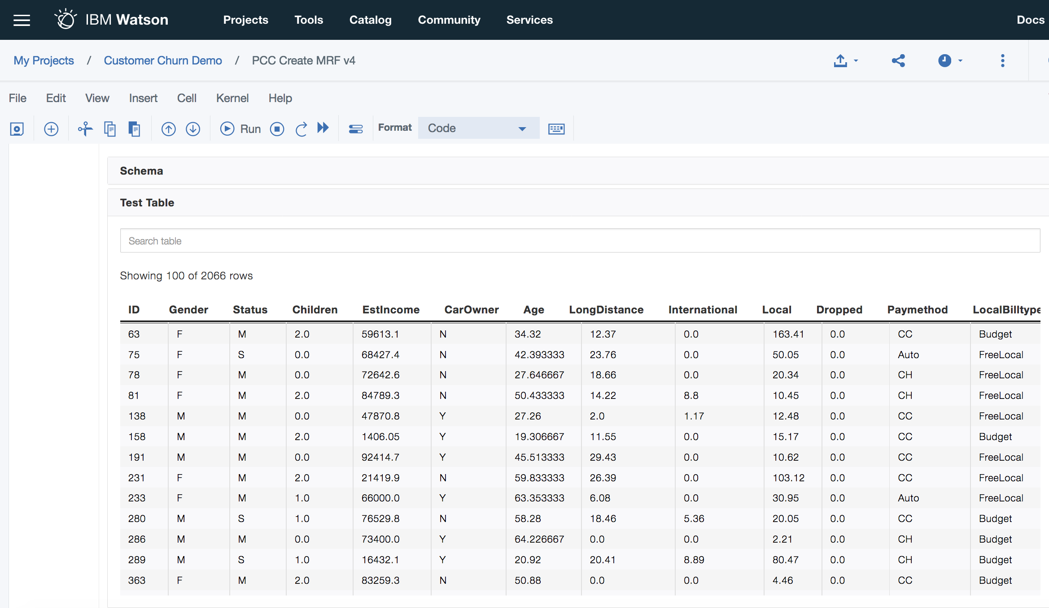
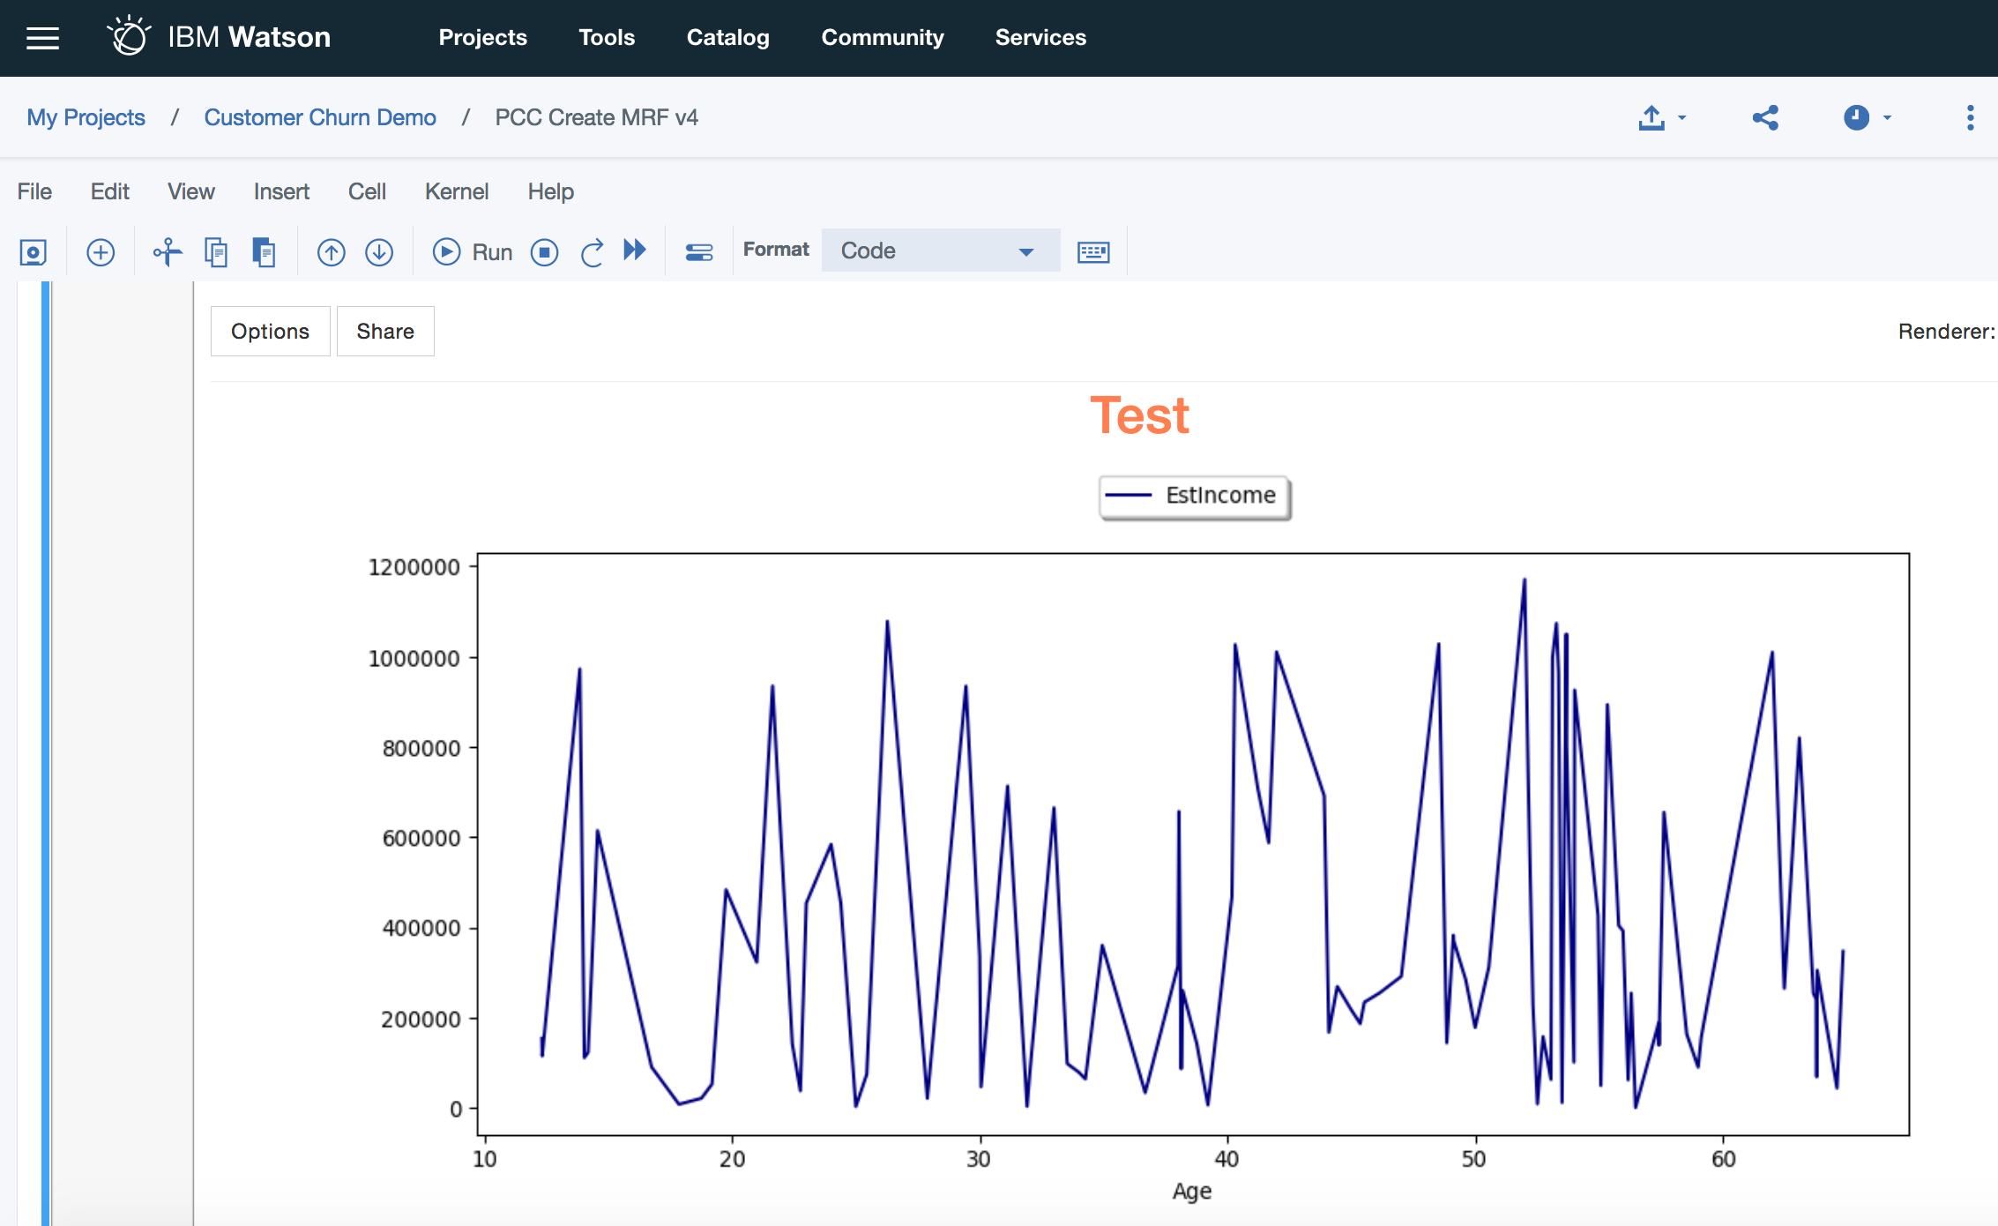
Data Visualization in a Notebook
Aids in understanding the data for selection and preparation
Helps to communicate insights
Tables and visualization tools can be used to review the data for accuracy or to identify data issues and review the structure of the data elements. Multiple graphic formats are available through pixiedust, brunel, bokeh, graphviz, seaborn and shiny apps as an example.

Slide 9
Questions

Slide 10
What we completed during this session
During this session you received an:
Understanding of how to build and publish a model using Python in a Jupyter notebook
Understanding of using:
Data Visualization
Model Execution
Machine Learning

